Slide 1
M&A as Transformer of the Automotive Industry
Intro to the course
& organizational issues
Prof. Dr. Mark Wahrenburg, Edoardo Pilla, Daniel Saad
This session is recorded: link will be available on OLAT​
1
Notes:
1

Slide 2
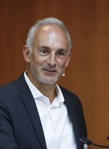
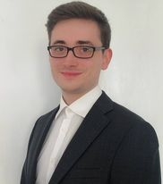
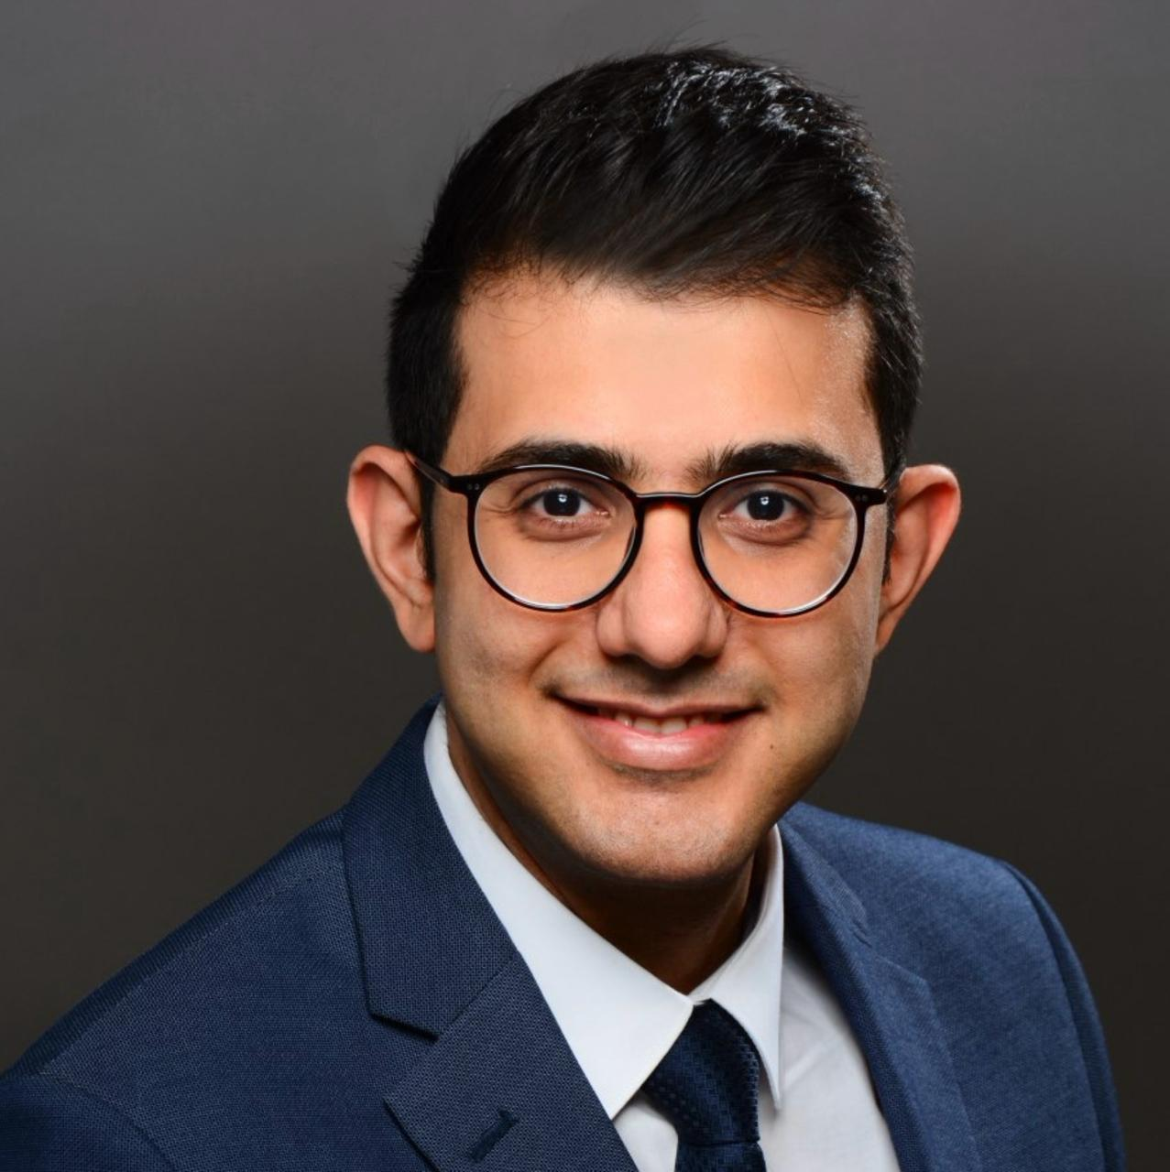
Introduction to the Team
Prof. Dr. Mark Wahrenburg
Professor of Banking and Finance at Goethe University
Edoardo Pilla
Research Assistant and PhD Candidate at Goethe University
Daniel Saad
AI Solutions Architect at Mercedes-Benz and PhD Candidate at Goethe University

Slide 3
This seminar consists of 3 parts
Term paper (case studies)
Each student assigned to one case and one cluster (team) of related cases
Each student contributes ca. 6 pages, AI-supported
One term paper per team – with joint section (e.g. conclusions, references + annex with detailed AI usage log)
Term papers are presented and discussed during the seminar
Detailed information, guidelines, and allocation of students: See OLAT
2. Oxford-style debates
Groups of up to 3 students advocate for or against a strategic decision
Research and statement of propositions/oppositions based on AI
Topics assigned one week prior to seminar week
Guidelines and schedule on OLAT
3. M&A related corporate valuation exercise
Team work
Data and materials handed-out during seminar, one day to work on
Presentation & discussion of results in class
3

Slide 4
Learning outcomes and goals
See how M&A is shaping firms & industries
Learn to effectively use AI (agents) to inform and prepare a report
Learn to create concise argument maps and exhaustive LLM wikis
Learn to reconcile own statements with reliable sources
Learn to debate / cooperate in a team
Learn to do a professional valuation like investment bankers do
Have fun!

Slide 5
Seminar registration confirmation and term paper cluster/topic allocation
Fill in Google Form until 07.05.2026 EoD
We will forward the link after this introductory meeting via email
You can express up to three preferences on topical areas for your term paper
If shared with us, we will circulate phone (WhatsApp) numbers across team members for easier coordination
Based on participating students, case studies will be assigned by 08.05.2026 EoD
Additional literature and guidelines for term paper and related presentation will be available on OLAT after this introductory meeting
Topics will NOT be assigned to students who do not confirm participation by 07.05.2026 EoD
Get in touch with us if you encounter issues when filling in the Google Form

Slide 6
Online Q&A
A chance to ask organizational and technical questions on the AI-based infrastructure before starting your work
Zoom meeting on 08.05.2026 at 13:00 (CET)
Invitation link will be forwarded via email

Slide 7
Grading
Prerequisite: participation throughout the seminar week!
Term paper preparation and presentation
Key points: quality and focus of analysis, accurate and properly cited sources, team work: comparison across cases and generalizable lessons learned
Detailed documentation of AI related activities for the term paper
Focus on employed prompts and iterations required to refine output
Goal is eliminating hallucination and unsupported claims
Assignments and communication: in English
Literature is partly English and German

Slide 8
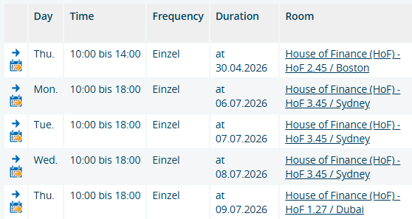
Timeline (subject to adjustments)
27.4 – Pre-reading materials on AI out
30.4 – Intro meeting and session on agentic frameworks
7.5 – Deadline for seminar registration confirmation (Google Form)
8.5 – Term paper topics and assignment out, online Q&A
29.6 – Term paper due / Oxford-style debate topics allocated
6.7 – Term paper presentations
7.7 – Oxford-style debates
8.7 – Intro to company valuation / Valuation case
9.7 – Valuation case discussion and wrap-up

Slide 9
Where to get started with literature
Company financial statements & disclosures contain a lot of information
Classics
Google Scholar
JSTOR Home
SSRN Home Page
GenAI tools
Elicit: AI for scientific research
OpenRead - AI Research Platform | Research Intelligence for Everyone
SciSpace AI Research Agent | 150+ Tools, 280 M Papers
9

Slide 10
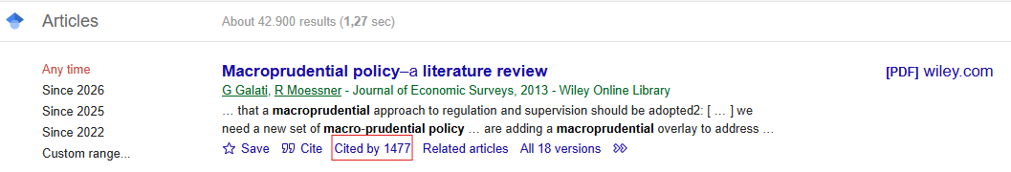
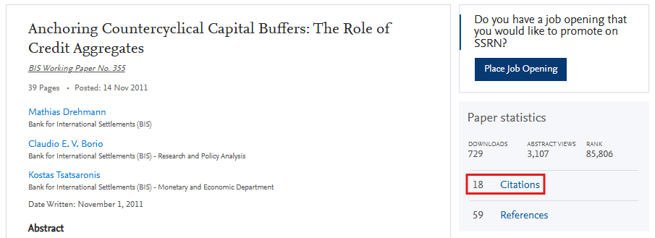
Who has cited a given article?
Google Scholar
SSRN
10

Slide 11
Closing remarks
Keep a critical distance: press statements are inherently biased (“This M&A will…”)
Analyze each case from the viewpoint of a financial (M&A) perspective
Consider different goals of stakeholders (managers, shareholders, employees...)
Argue clearly, fact based & focused
Derive clear lessons and compare the cases within a cluster
11

Slide 12
Additional links
Recommended background textbook (HRZ login required)
“Mergers, acquisitions, and other restructuring activities: an integrated approach to process, tools, cases, and solutions” (DePamphilis, Donald M.) - UB FFM: Title: Mergers, acquisitions, and other restructuring activities
AI infrastructure Github repository
dsaad68/research-template
Term paper writing guidelines
Fachbereich 02 - Wirtschaftswissenschaften: Writing Guidelines
Translation and writing support
DeepL Translate: The world's most accurate translator
12

Slide 13
Contacts
Announcements and public forum on OLAT
wahrenburg@finance.uni-frankfurt.de
pilla@finance.uni-frankfurt.de
Get in touch via email for organizational issues ONLY
Guidance, Q&A, and discussion among students on OLAT
Questions that are directly part of the examination will NOT be answered
13

Slide 14
Annex: List of clusters and case studies (1)
Cluster | Case Studies
Horizontal Mergers and Takeovers | Daimler Chrysler merger Fiat’s acquisition of Chrysler
Diversified Conglomerates | Daimler-Benz (Integrated Technology Group) Continental AG
Divestments, Spin-offs and IPOs | Ferrari IPO Porsche AG IPO
Truck Industry – Separation | Volvo – Trucks vs. Cars Mercedes-Benz Group – Cars vs. Daimler Truck Volkswagen Group - Traton
Strategic Alliances, Joint Ventures, Equity Alliances | Nissan – Renault Porsche – Volkswagen Toyota – Subaru
China Strategies | Geely SAIC Motor BYD NIO

Slide 15
Annex: List of clusters and case studies (2)
Cluster | Case Studies
How to Build a New Car Company | Rimac Automobili Fisker Inc.
Robotics in the Automotive Industry | KUKA – Acquisition by Midea Agile Robots Boston Dynamics
Autonomous Driving – Ownership Models | Ford – Argo AI General Motors – Cruise Intel - Mobileye
Software and Operating Systems – Build, Buy, or Partner | Volkswagen – CARIAD Volkswagen – Rivian Stellantis – Foxconn / Amazon
Battery and EV Technology – Investing under Uncertainty | Volkswagen – QuantumScape Stellantis – Battery Joint Ventures Northvolt

